Slide 1
Resume Classification using NLP

Slide 2
Group Members-
Mr. Shreyash Subhash Hiwale
Miss. Pragati Rajendra Swami
Mohammed Sohail Hussain

Slide 3
Introduction-
The amount of resume that companies get is insane. It takes a lot of time to check every single resume manually.
In order to reduce this effort, Resume classification can be done using Machine Learning.
The document classification solution should significantly reduce the manual human effort in the HRM. It should achieve a higher level of accuracy and automation with minimal human intervention Sample Dat Set.

Slide 4
Data set-
The data set contains 79 resumes divided into 4 categories. They are –
Peoplesoft resumes
React resumes
SQL Developer Lightning insights resumes
Workday resumes
The resume are in 3 different formats-
.doc
.docx
.pdf

Slide 5
Extraction-
The task involved processing files with varied extensions: .docx and .doc formats.
Utilized the Python-.docx library to extract content from .docx files seamlessly.
For .doc files, employed the Win32 library to open and then save them as .docx extensions.
After conversion, utilized Python-.docx to read the newly created .docx files.
Leveraged the Pyresparser library to efficiently extract skills from resumes.
This approach ensured comprehensive handling of diverse file formats, facilitating seamless extraction and analysis of resume data.
By combining these libraries, the workflow enabled efficient processing of both .docx and .doc files, ensuring compatibility and streamlined extraction of pertinent information.

Slide 6
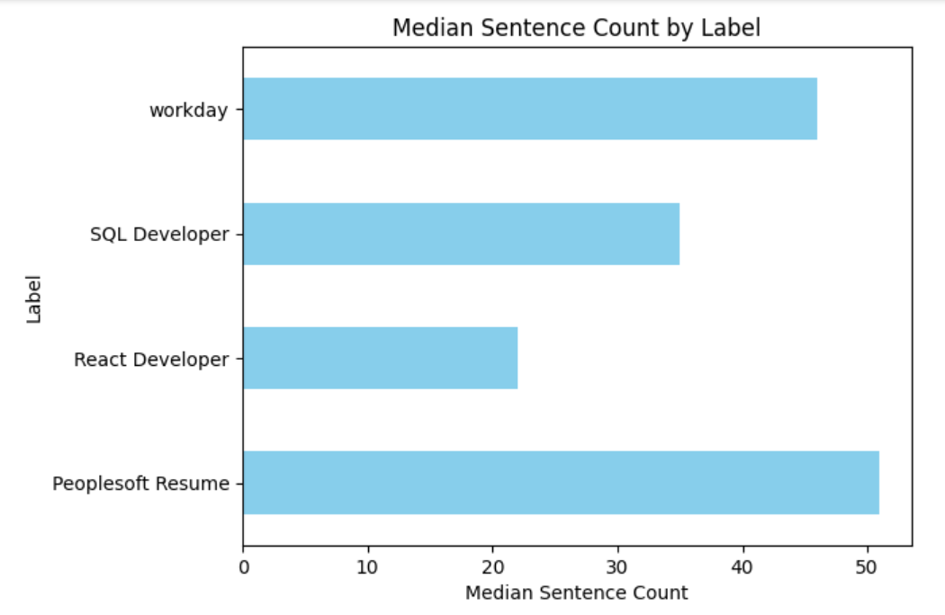
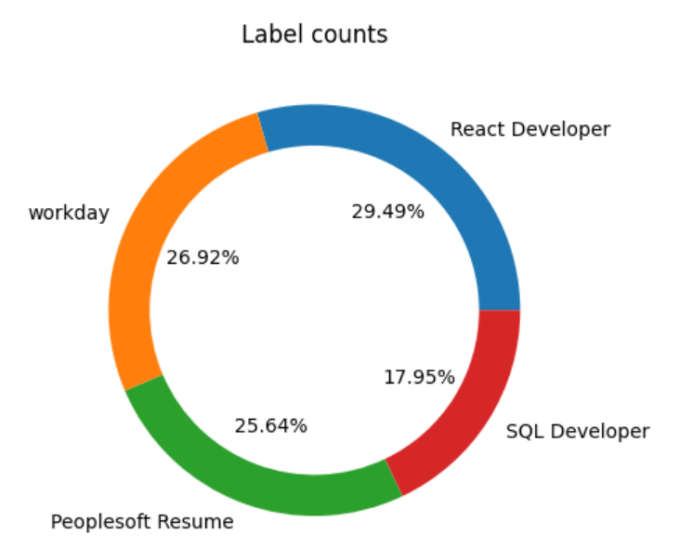
EDA and Data Pre-processing

Slide 7
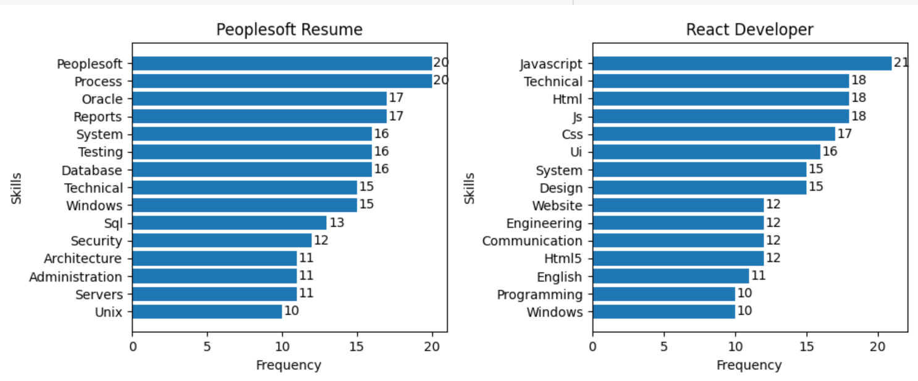
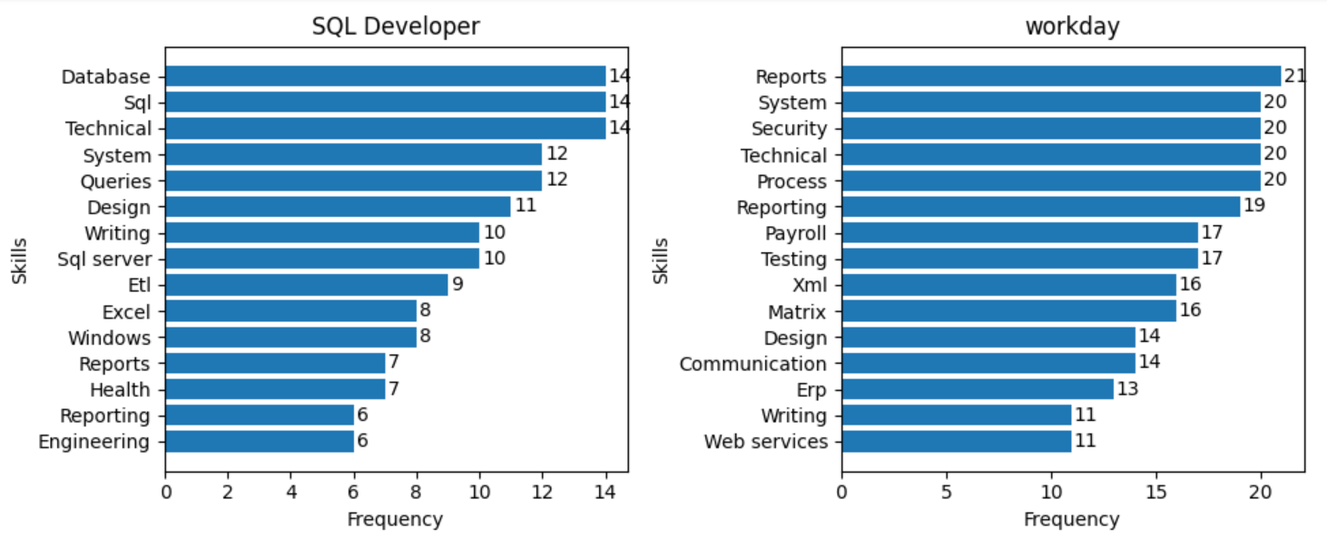

Slide 8
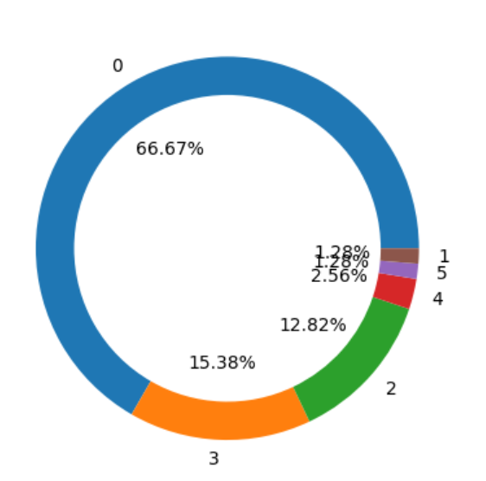
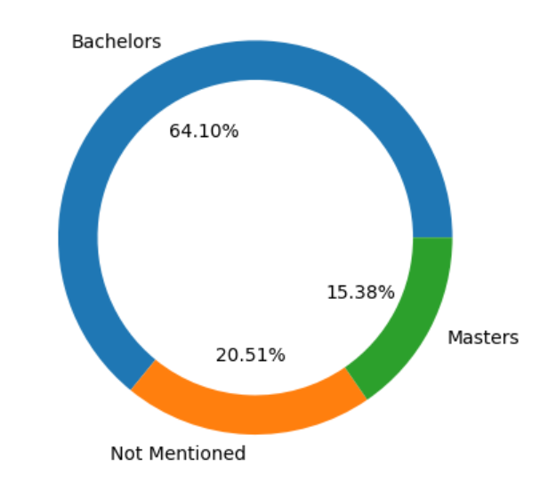
Around 66% people have not mentioned any language.
around 20% people have not mentioned there education
19% people speak 3 or more languages.

Slide 9
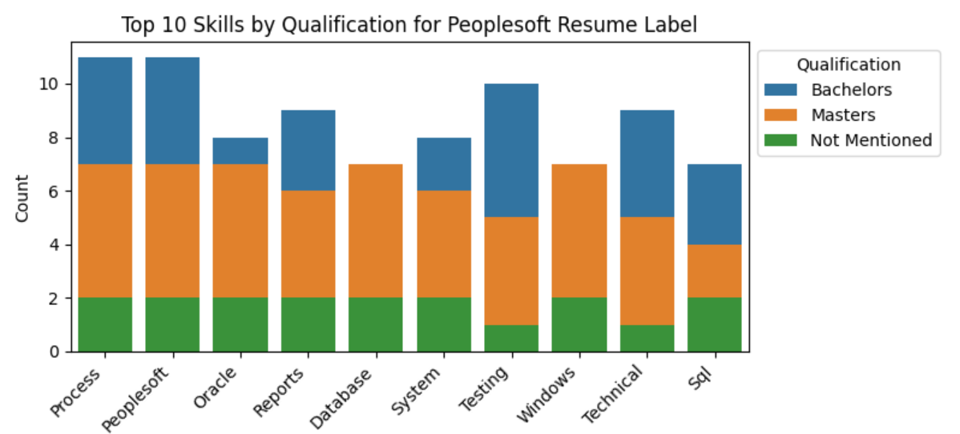
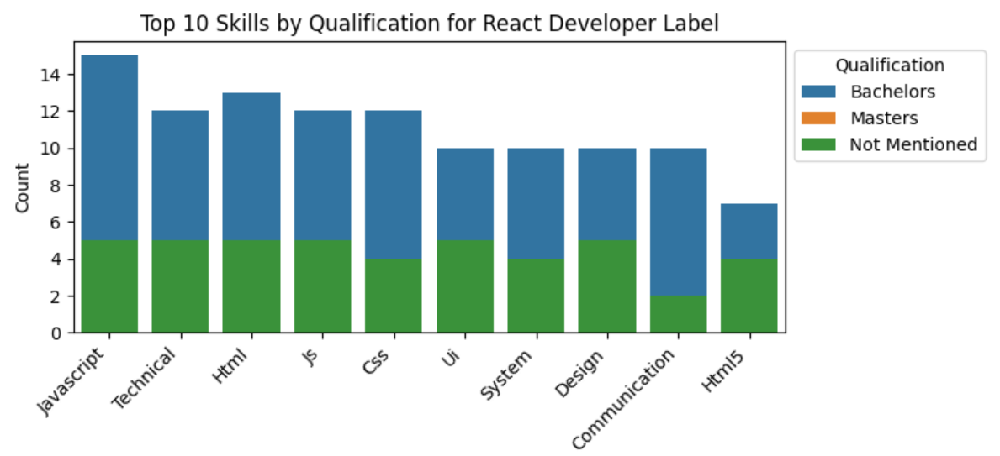

Slide 10
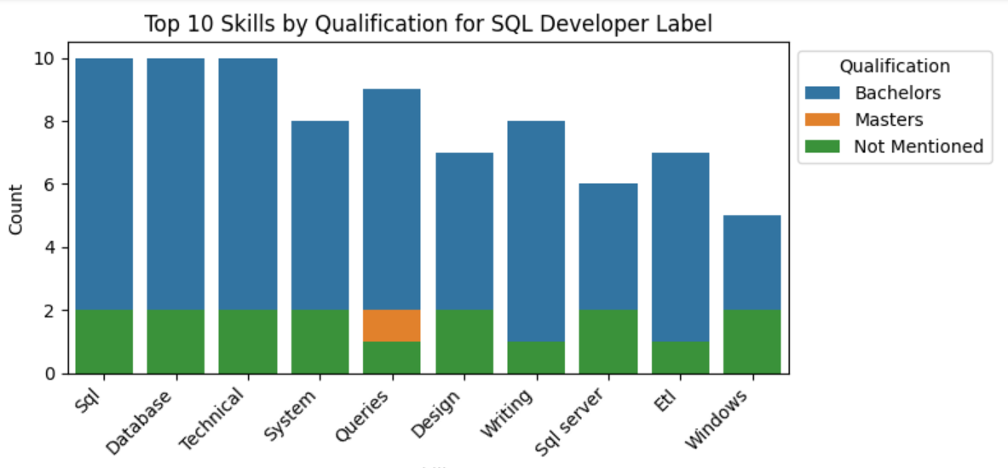
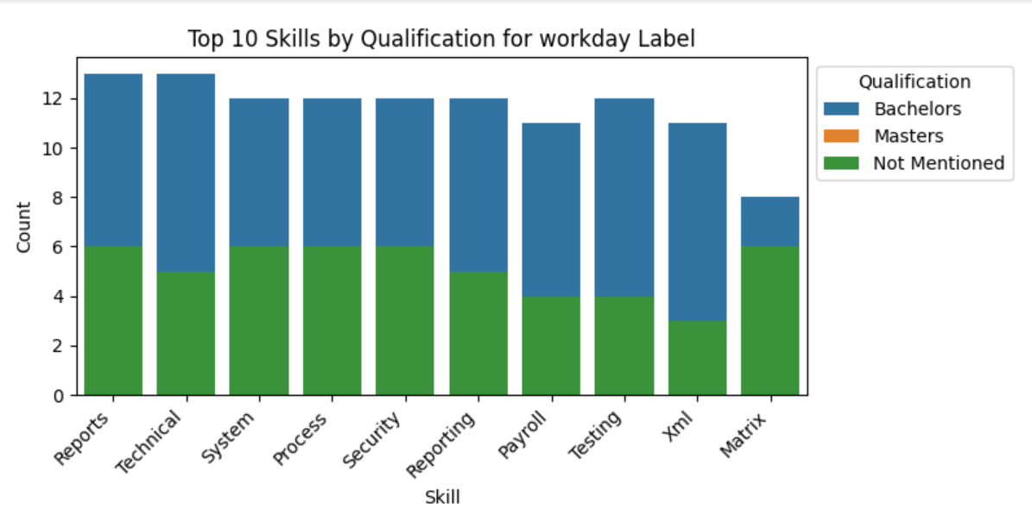
For workday , SQL developer, and react developer top 10 skills are covered with people having bachelors degree.
People soft top 10 skills require people having masters degree.

Slide 11
Text Processing-
Remove patterns.
Remove Urls
Text cleaning – Punctuations, lowercase, Square brackets, etc
Removing Emogis
Applying Tokenization
Removing stopwords
Applying Lemmatization
Applying CountVectorizer
Applying CountVectorizer on NGrams

Slide 12
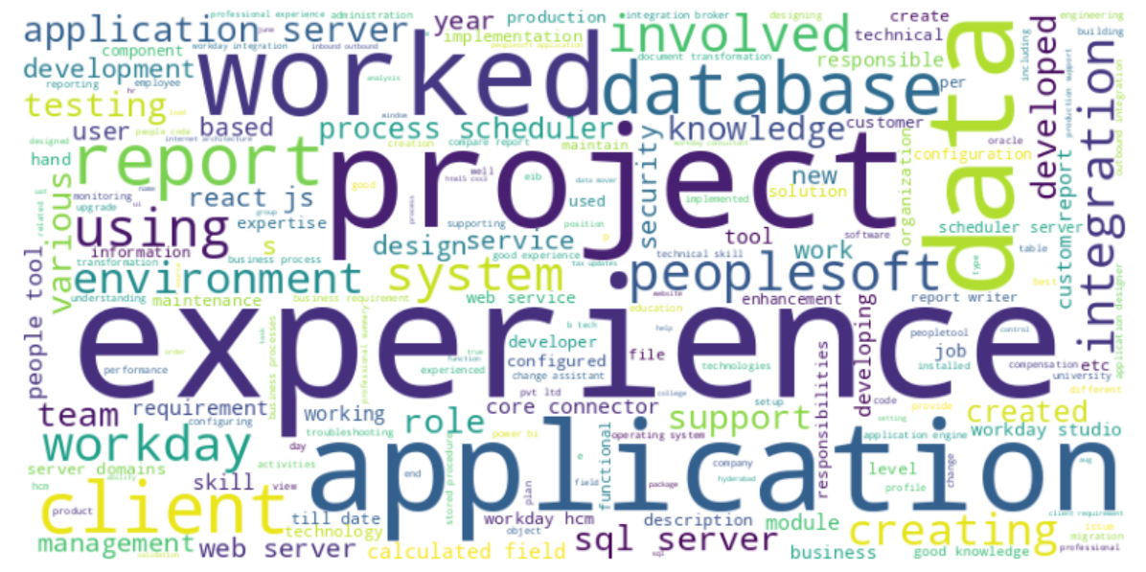
Most used words-

Slide 13
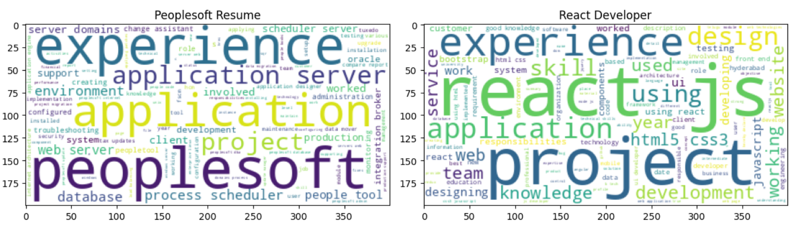
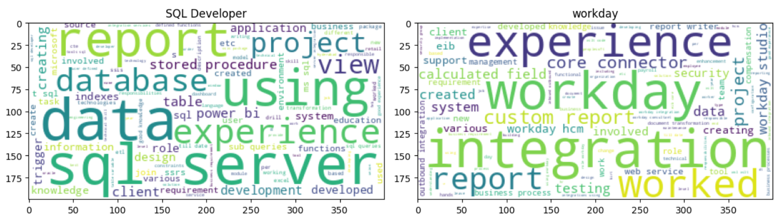
Word cloud-

Slide 14
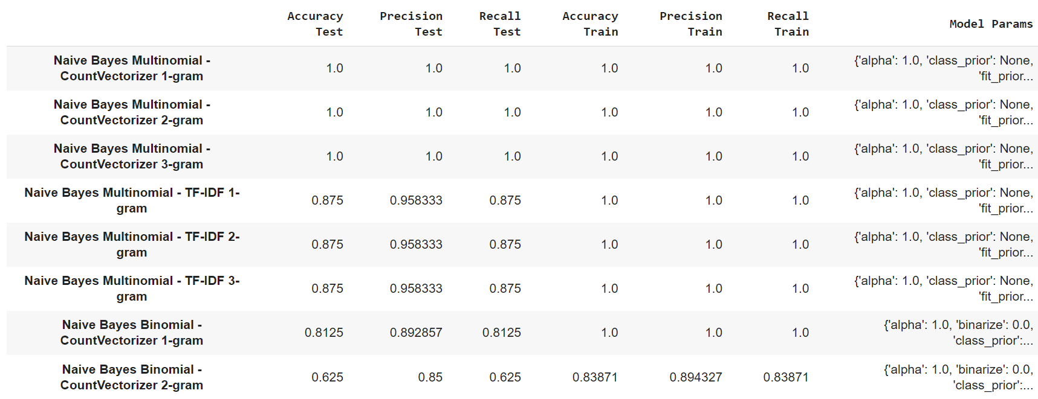
Model building-

Slide 15
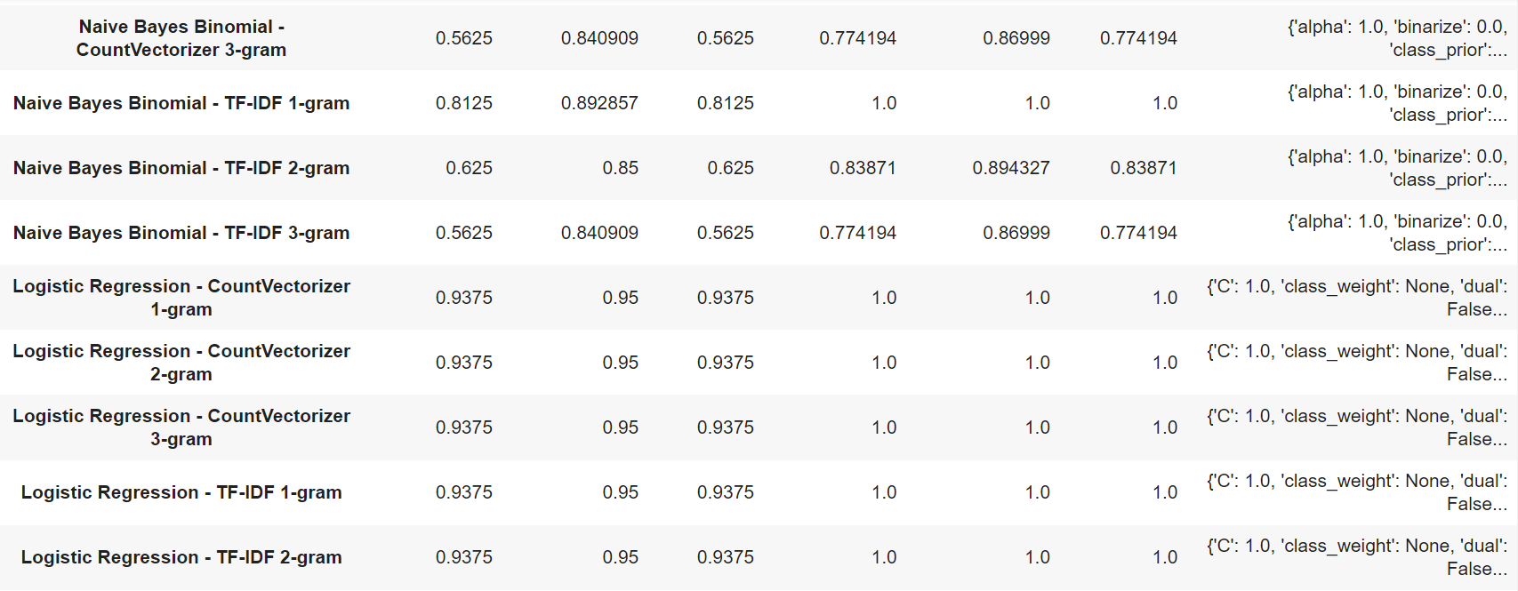

Slide 16
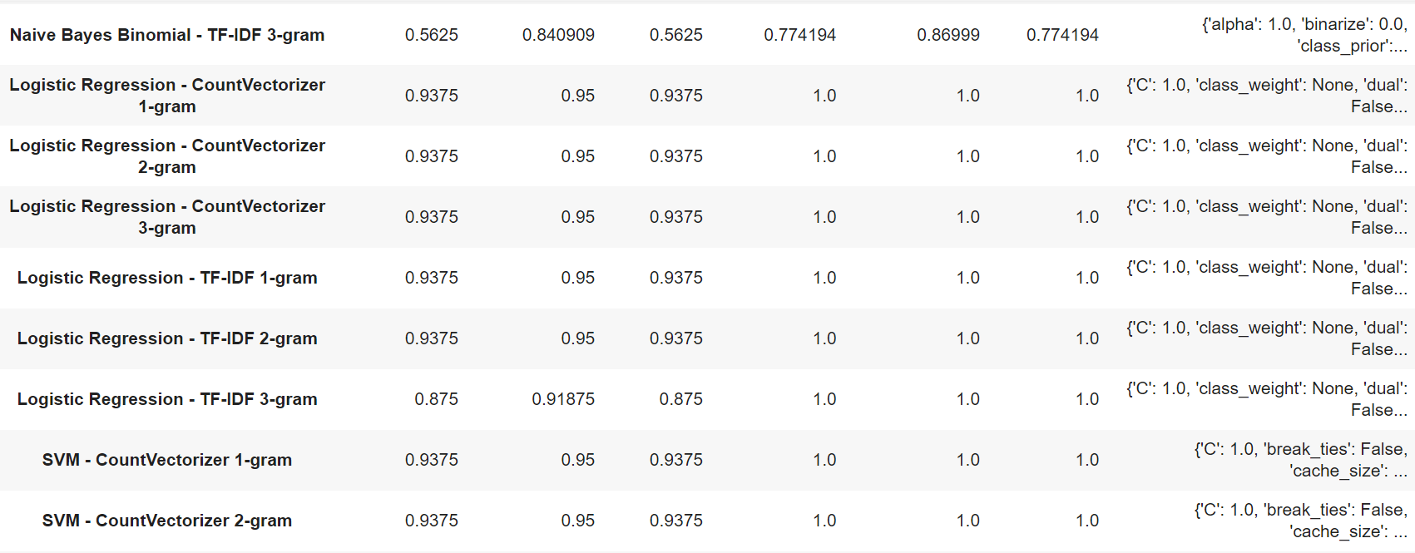

Slide 17
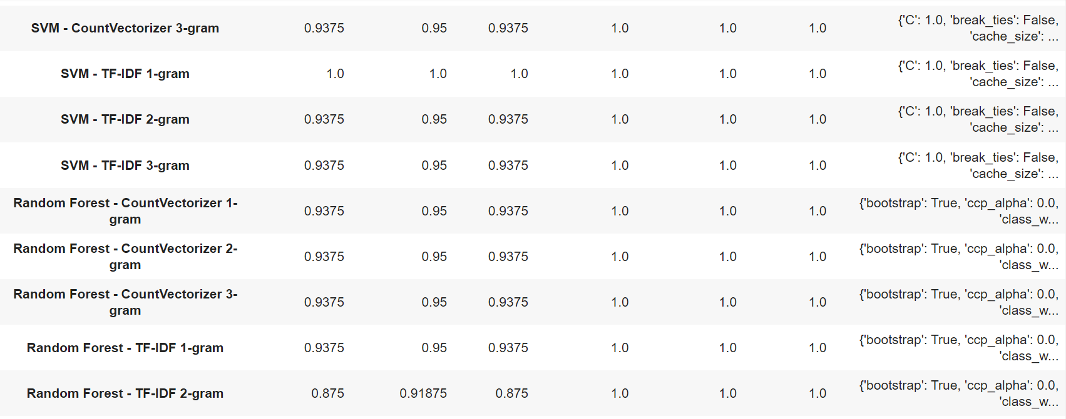

Slide 18
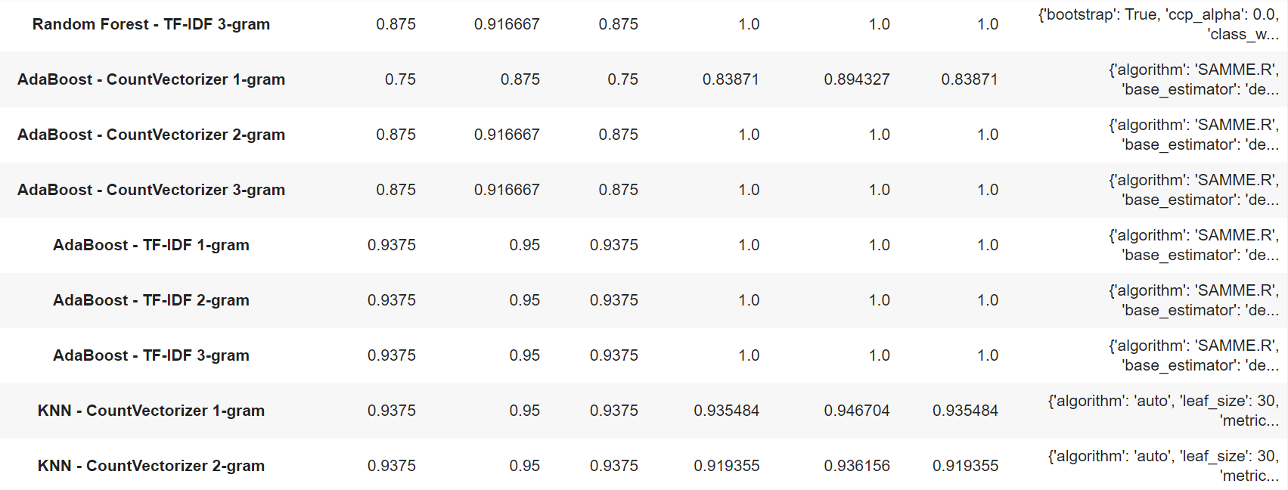

Slide 19
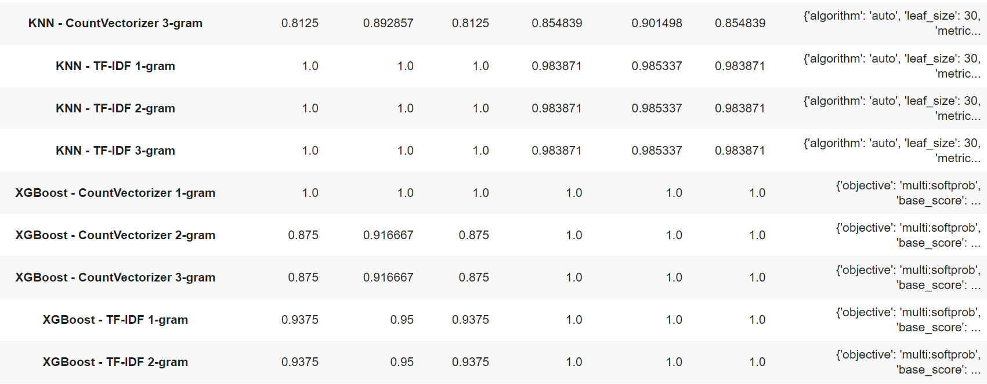

Slide 20
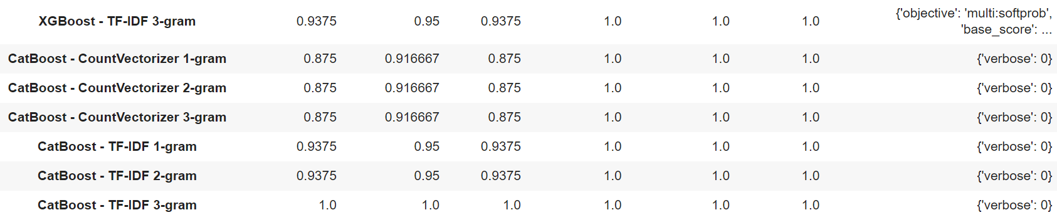

Slide 21
Selection of appropriate metric
giving wrong prediction is considered as a big mistake because the candidate applying for some particular position would be called for wrong position interview which eventually leads in loss of time for both interviewer and candidate also loss of resources to setup the interview so we need to check that the model gives more true positive and less false positive

Slide 22
Model Selection -
Selected Naive Bayes Multinomial over KNN despite similar metric scores.
KNN is a lazy learner; it does no work during training, calculating distances only during testing.
Utilizes Euclidean distance for distance calculation.
Dataset employs count vectorization with 1000 columns from grid search.
In higher dimensions, Euclidean distance becomes less effective.
Calculating distance with each training point in higher dimensions is time-consuming.
Naive Bayes offers faster predictions due to its simplistic probabilistic model.
Naive Bayes particularly efficient with sparse, high-dimensional data.
Despite comparable performance, Naive Bayes was chosen for its computational efficiency.
Decision driven by consideration of prediction time and dimensionality.

Slide 23
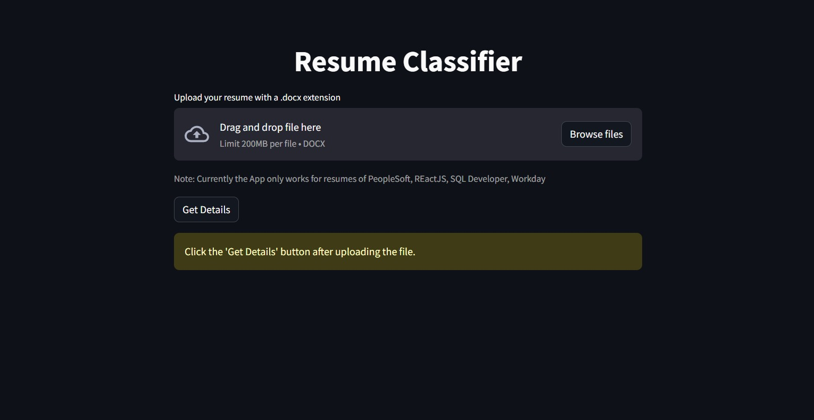
Model Deployment -

Slide 24
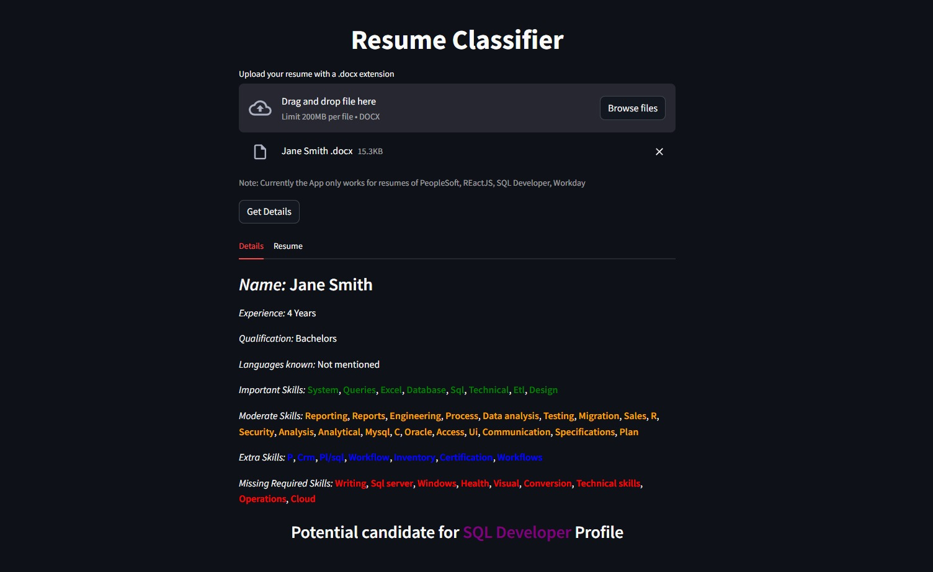

Slide 25
Challenges Faced -
Mention extraction the data from different extension files was difficult as different extension require different libraries so a research was done with the help of web and chatgpt to use these different libraries .
There were 4 different subfolders for different categories of resumes so to over come this made a custom function that takes the path of root directory of these subfolders so it becomes easier and automated to extracted data if the files are located in different subfolders.
The model building and evaluation process require training and evaluating different algorithms and different technique to make vectors of words so to automate the process of model building and evaluating the model we made a custom function so that each combination of model and vector technique with different parameter can be don't and compared at once.

Slide 26
Thankyou

